Slide 1

FraudShield - AI Powered Fraud Detection
Protecting Your Business from Financial Fraud
Github Lablab team page

Slide 2
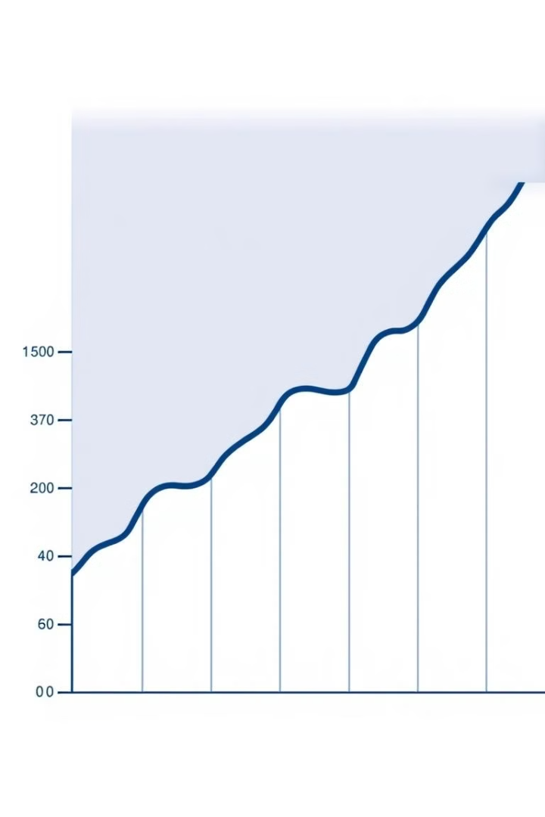
The Story Behind FraudShield
Fraud is a growing problem in the digital world. Businesses lose billions of dollars every year due to online scams. FraudShield was created to stop fraud using smart AI technology.
1
Businesses lose billions of dollars every year to online scams.
2
Fraudsters are getting smarter and harder to catch.
3
FraudShield uses AI to detect and prevent fraud.

Slide 3
The Problem We Solve
Fraudsters are getting smarter and harder to catch.
Current systems are slow and outdated.
Fraud costs businesses billions of dollars annually and damages their reputation.

Slide 4
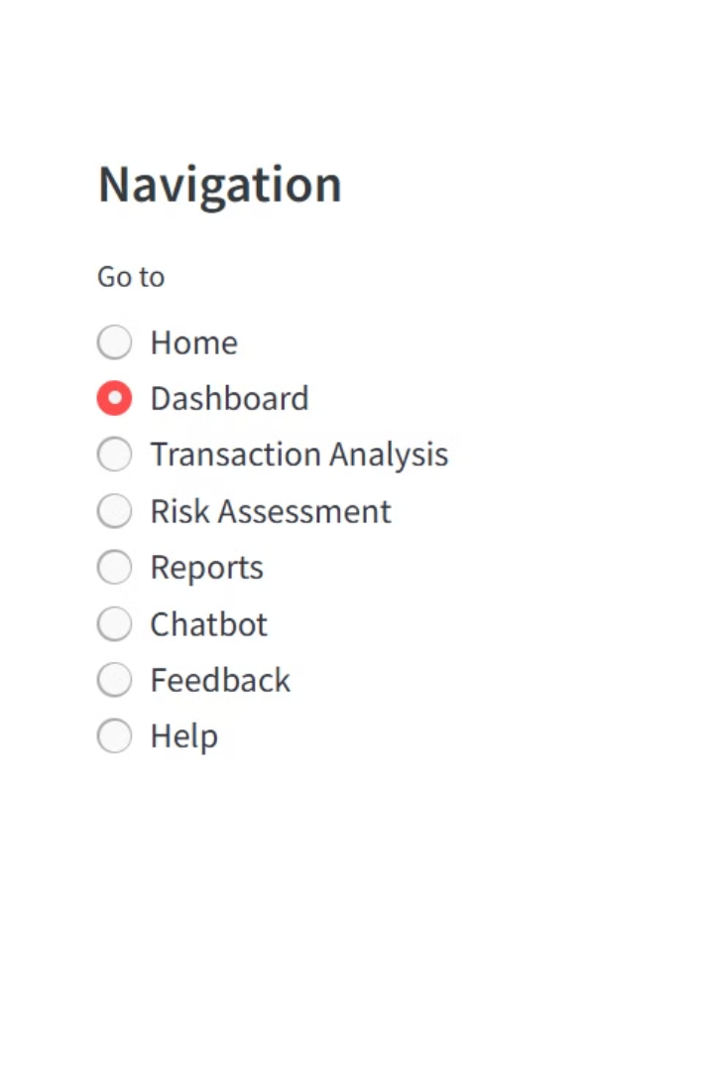
Our Solution-Fraudshield
Real-time fraud detection
Makes Transaction Analysis
Provides risk scores and detailed reports
Offers an interactive chat bot

Slide 5
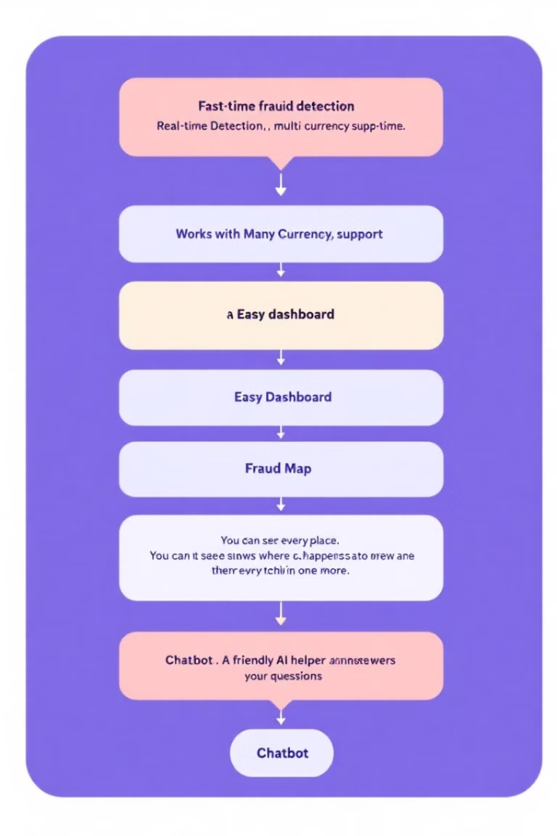





Key Features of FraudShield
Real-time fraud detection
Multi-currency support
Interactive dashboard and visualizations
AI chatbot for instant support
User-Friendly Interface

Slide 6
Technologies Behind FraudShield
AI/ML
Programming
Web App
IBM Watsonx and Granite AI
Python
Streamlit
Charts
APIs
Plotly
IBM Watsonx API and Exchange Rate API

Slide 7




Who Needs FraudShield?
Banks
E-commerce
1
2
Protect financial transactions
Secure online payments
Businesses
4
3
Fintech
Prevent financial loss
Minimize fraud risk

Slide 8
Business Value
Saves Money
Ensures Compliance
Significantly reduces financial losses by preventing fraud.
Helps maintain adherence to laws and industry regulations.
Enhances Trust
Scalable Solution
Increases customer confidence and loyalty through secure transactions.
Adapts to the growing needs of both small and large businesses.

Slide 9


Competitor Analysis
Other Tools
Why FraudShield is Better
Some tools are slow or don’t use AI.
It works in real-time.
It handles many currencies.
It uses advanced AI.
It’s easy to use.

Slide 10
How FraudShield Works
Enter Transaction Details
You enter the sender, receiver, amount, and currency.
Currency Conversion
The system converts the amount to USD for analysis.
AI Risk Assessment
FraudShield's AI analyzes the transaction for potential fraud.
Risk Score
You receive a risk score, indicating low, medium, or high risk.
Detailed Reports
Access detailed reports with charts and maps to understand fraud trends.

Slide 11
Future Plans
1
Enhance AI models with new data sources and algorithms
2
Expand our services internationally by incorporating multiple currencies and languages
3
Establish direct connections with bank systems
4
Use blockchain technology to ensure that all transactions are secure and transparent.

Slide 12

Thank You
We appreciate your time and interest in FraudShield.
Presented by
Sajjad Ahmad(Team leader) Muhammad Anique
Adam Derbel Unisha Acharya
Bibek Maharjan

